Slide 1
Model-
New
ExecuteSP
FillCombo
Encrypt
Decrypt

Slide 2
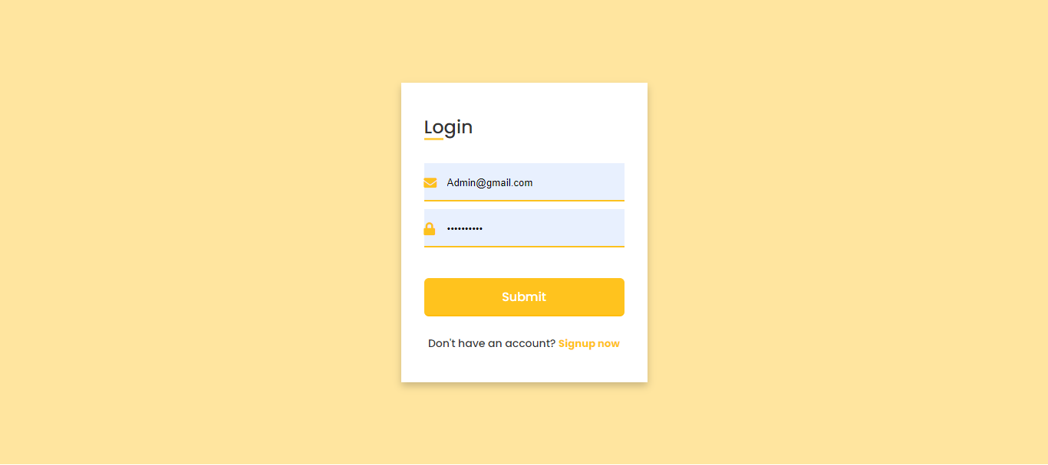
Login:-
Pages_Login_Load
btnLogin_Click
btnSignInToggle_Click

Slide 3
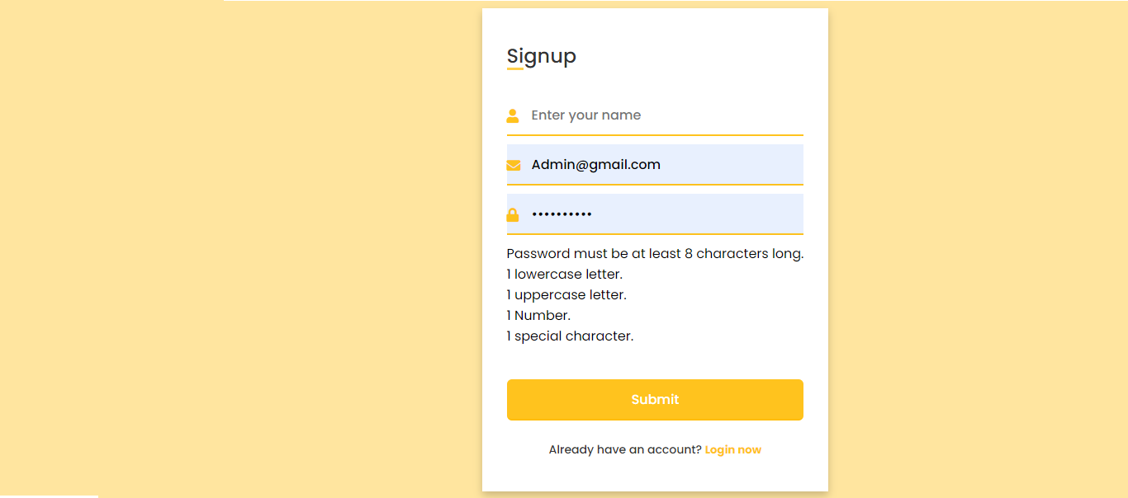
Signup:-
Pages_Login_Load
btnSignup_Click
ValidatePassword
btnLoginToggle_Click

Slide 4
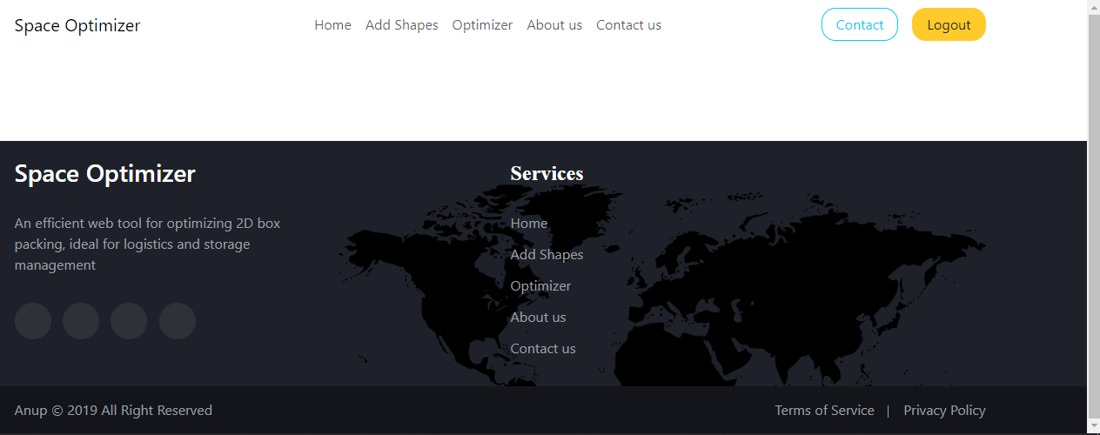
Master Page:-
MasterPage_Load
btnLogin_Click

Slide 5
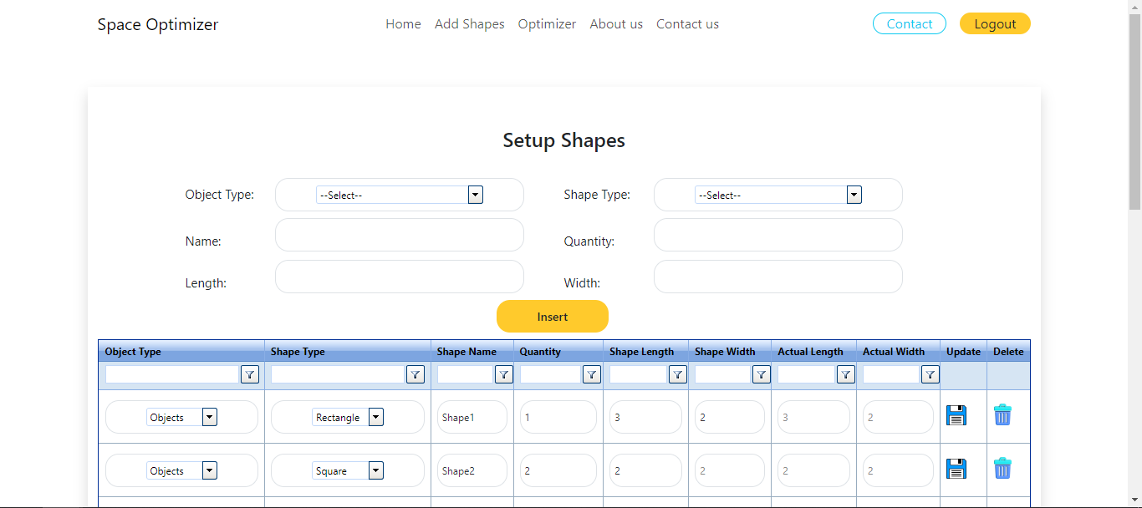
Setup Shape:-
Pages_AddShapes_Load
cmbShapeType_SelectedIndexChanged
cmbType_SelectedIndexChanged
TgridObjects_NeedDataSource
TgridObjects_ItemDataBound
btnInsert_Click
TgridObjects_ItemCommand

Slide 6
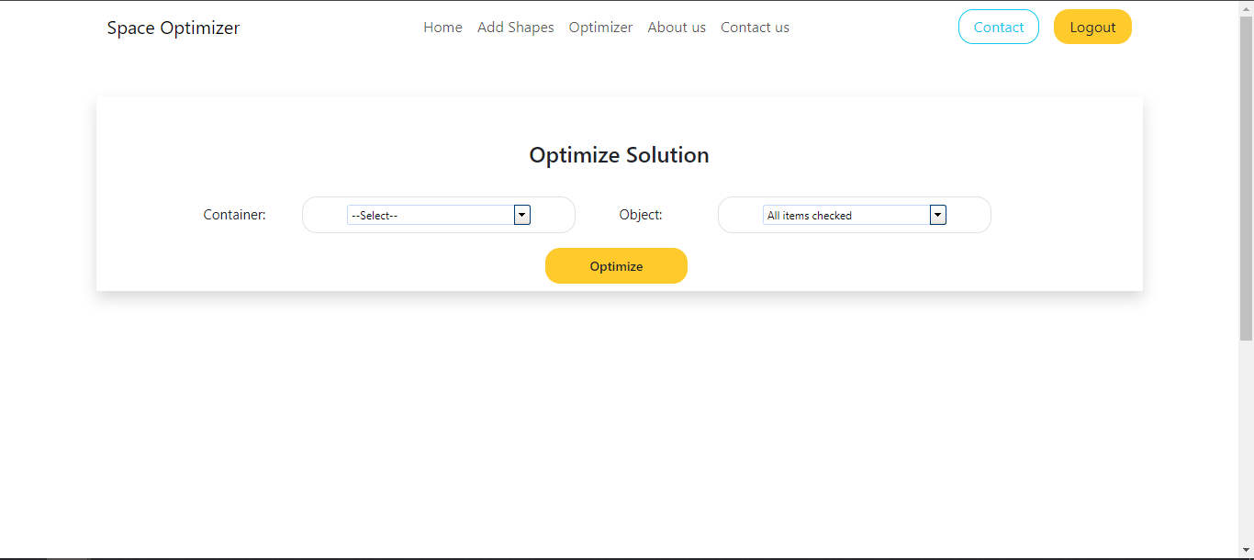
optimizer:-
btnOptimize_Click
btnOptimize_Click
cmbContainer_SelectedIndexChanged

Slide 7
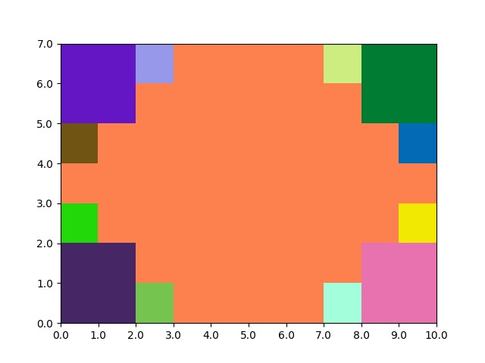
API:-
optimize
Main
create_Rectangle
create_Triangle
create_Parallelogram
create_Rhombus
create_Hexagon
Outcomes
resize_2d_array
add_arrays_with_rotation
rotate_matrix_right
shift_matrix_down
convert_to_3d_array
random_number

